Slide 1
UP to interpretation
Python Implementations and What They’re Good For

Slide 2
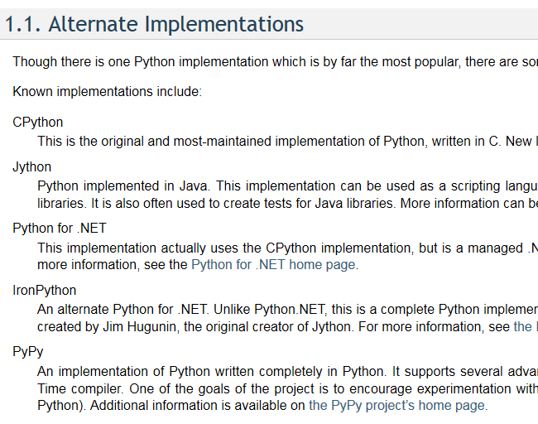
What is “python”?
The Spec: https://docs.python.org/2/reference/

Slide 3

Why Would I use it?
Since this is a Python meetup, you probably already have your reasons .. but since I’m talking, I’ll give you mine:
rapid prototyping
fast debug/execute cycle
tons of libraries
ubiquity
Good Windows support; preinstalled on everything else
easy to read
Because you’re going to have to read it at least 10x after you write it, and it’s always harder to read than to write

Slide 4

okay, so which one should I use? or: why are there so many choices?
two main factors:
compatibility: what code are you interfacing with
efficiency: who doesn’t want faster code?

Slide 5

efficiency!!
Fun to talk about; easy to measure. not really that important.
(if it is actually important, python is probably not the best tool)
http://paulgraham.com/hundred.html

Slide 6
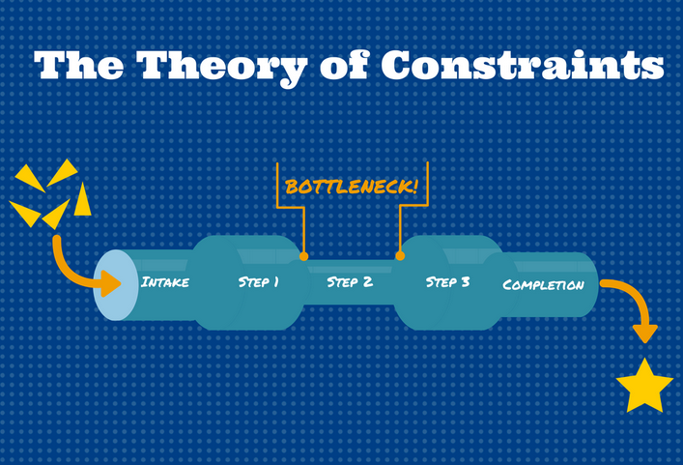
quick answer to why *cpu* efficiency doesn’t matter (a.k.a. why people use python in production)
CPU
Network/Disk etc

Slide 7

Compatibility (my fav thing about python, other than the lack of curly braces)
Also the answer to efficiency: profile and write the hot spots in C (or C#, or Java, or ...)
Using ctypes, it’s easy to call into C from any of the python implementations
IronPython is built on the “DLR”, which gives the slickest integration story of them all IMHO

Slide 8

Let’s write some code ...
Call Some C (ctypes)
Call and Be Called (IronPython)
Serious Speed (PyPy & Numpy)

Slide 9
Some crude speed comparisons
http://www.cdotson.com/2014/08/nodejs-vs-python-vs-pypy-a-simple-performance-comparison/
http://speed.pypy.org/
http://smallshire.org.uk/sufficientlysmall/2009/05/22/ironpython-2-0-and-jython-2-5-performance-compared-to-python-2-5/
http://karlheinzniebuhr.github.io/en/2015/09/28/C-vs-Go-vs-pypy-vs-Python/

